Slide 1
Efficient Algorithms
Ekkapot Charoenwanit
Electrical and Computer Engineering (ECE)
TGGS
KMUTNB

Slide 2
About Me
Ekkapot Charoenwanit
Office:
401
Office Hours:
Wednesday Afternoon 13:00-16:30

Slide 3
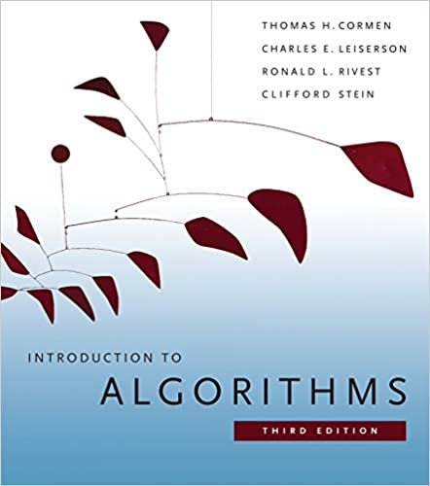
Textbook known as CLRS
The third edition is recommended, but the second edition is also fine.
***Available at the main library

Slide 4

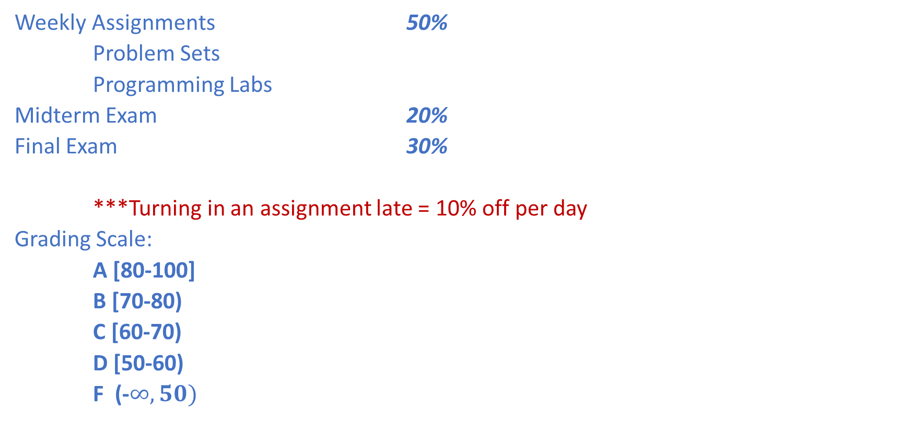
Course Logistics
Weekly Assignments 50%
Problem Sets
Programming Labs
Midterm Exam 20%
Final Exam 30%
***Turning in an assignment late = 10% off per day
Grading Scale:
A [80-100]
B [70-80)
C [60-70)
D [50-60)
F (-$∞,50)$

Slide 5
Course Contents
Asymptotic Analysis
Induction and Recurrence Relations
Data Structures
Searching and Sorting Algorithms
Divide and Conquer
Dynamic Programming
Greedy Algorithms
Graph Algorithms
State Space Search
NP-Completeness
Approximation Algorithms
Randomised Algorithms
Linear Programming
More advanced topics if time allows

Slide 6
The Hierarchy of Abstraction in Computing
Problem
This course spans these 3 abstraction layers:
Problem
Algorithm
Programming Language
Algorithm
Prog Lang
OS
ISA
Microarch
Our focus will be on the Algorithm layer.
Logic Gate
Circuit
Physics

Slide 7
Lecture 1: Algorithm Analysis and Asymptotic Notations

Slide 8
Definition of Algorithms
An algorithm is a finite, unambiguous description for a sequence of computational steps to solve a computational problem.
Finite in this context means the algorithm must eventually terminate.

Slide 9
Algorithmic Complexity
How efficient an algorithm is can be measured by its algorithmic complexity
Time Complexity (Temporal)
How many computational step units are required?
How much time does the algorithm need?
Space Complexity (Spatial)
How much space does the algorithm need?
This course will focus more on Time Complexity.

Slide 10
Performance Analysis of Algorithms
There are generally two methods for analyzing algorithms’ performance:
Experimental Analysis:
Run code on a computer
Measure the running time for different problem sizes
Plot the result as a graph
Mathematical Analysis:
Express the number of elementary steps parameterized by the problem size

Slide 11
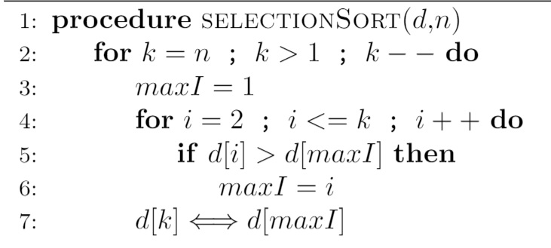
Selection Sort

Slide 12
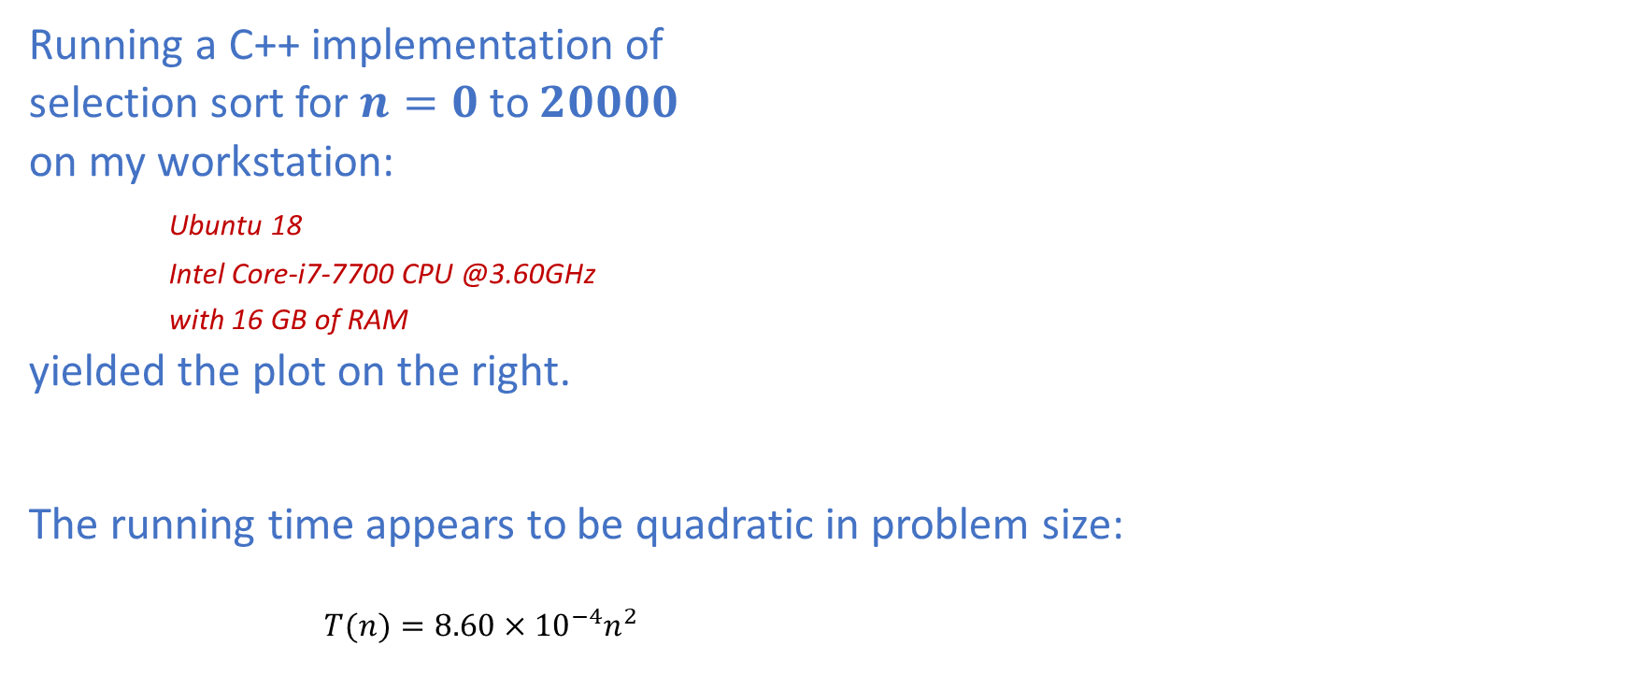
Experimental Analysis
Running a C++ implementation of
selection sort for $n=0$ to $20000$
on my workstation:
Ubuntu 18
Intel Core-i7-7700 CPU @3.60GHz
with 16 GB of RAM
yielded the plot on the right.
The running time appears to be quadratic in problem size:
$T(n)=8.60×{10}^{−4}n^{2}$

Slide 13
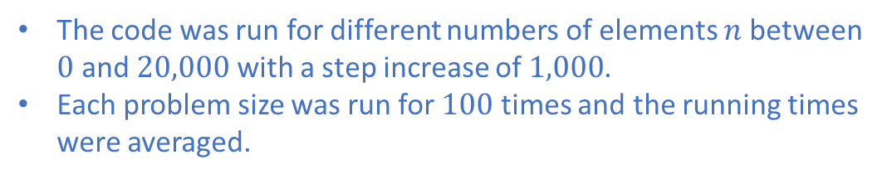
Experimental Analysis
Problem Size |  | Run Time
0 |  | 0
1000 |  | 900
2000 |  | 3421
3000 |  | 7724
4000 |  | 13735
5000 |  | 21632
6000 |  | 30946
7000 |  | 42289
8000 |  | 55003
9000 |  | 69744
10000 |  | 86362
11000 |  | 104374
12000 |  | 124170
13000 |  | 145146
14000 |  | 169105
15000 |  | 193949
16000 |  | 221006
17000 |  | 249132
18000 |  | 278904
19000 |  | 310715
20000 |  | 344296
The code was run for different numbers of elements $n$ between $0$ and $20,000$ with a step increase of $1,000$.
Each problem size was run for $100$ times and the running times were averaged.

Slide 14
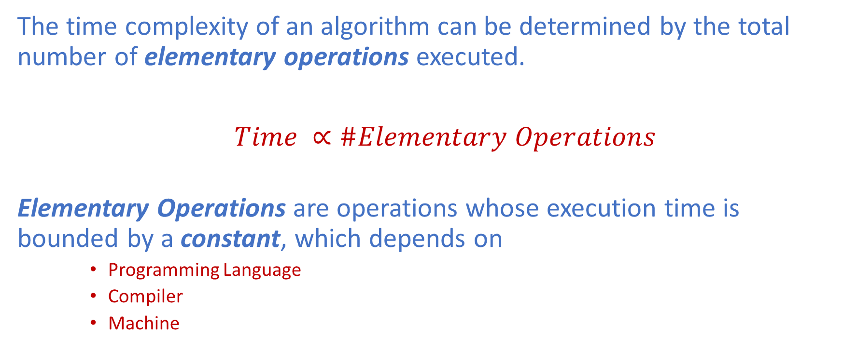
Mathematical Analysis
The time complexity of an algorithm can be determined by the total number of elementary operations executed.
$Time ∝\#Elementary Operations$
Elementary Operations are operations whose execution time is bounded by a constant, which depends on
Programming Language
Compiler
Machine

Slide 15
Approaches to Counting Elementary Operations
Count every elementary operations
impractical
Count only representative elementary operations
executed the most number of times
called barometer operations
What are the barometer operations in the code of selection sort shown on the right?

Slide 16

Approaches to Counting Elementary Operations
Count every elementary operations
impractical
Count only representative elementary operations
executed the most number of times
called barometer operations
Barometer : $d\left[i\right]>d[maxI]$

Slide 17
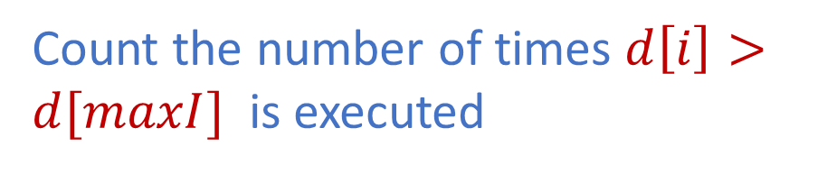

Approaches to Counting Elementary Operations
Count the number of times $d\left[i\right]>d[maxI]$ is executed
Inner Loop
$$\sum_{i=2}^{k}{1}$$

Slide 18


Approaches to Counting Elementary Operations
Count the number of times $d\left[i\right]>d[maxI]$ is executed
Outer Loop
Inner Loop
$$\sum_{i=2}^{k}{1}$$
$$\sum_{k=2}^{n}{}$$

Slide 19
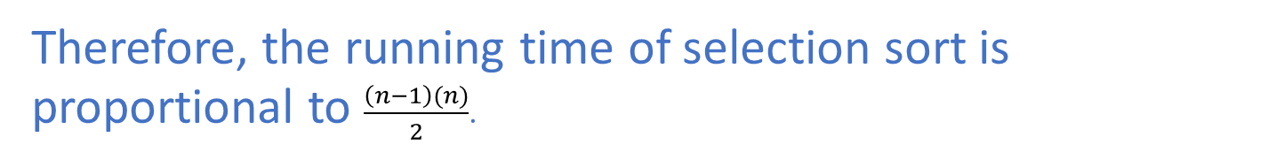
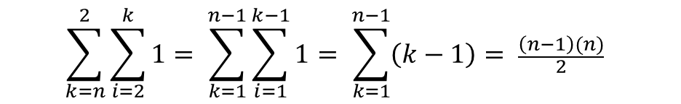
Approaches to Counting Elementary Operations
Count the number of times $d\left[i\right]>d[maxI]$ is executed
$$\sum_{k=n}^{2}{\sum_{i=2}^{k}{1= \sum_{k=1}^{n−1}{\sum_{i=1}^{k−1}{1= \sum_{k=1}^{n−1}{\left(k−1\right)= \frac{\left(n−1\right)(n)}{2}}}} }}$$
Therefore, the running time of selection sort is proportional to $\frac{\left(n−1\right)(n)}{2}$.

Slide 20
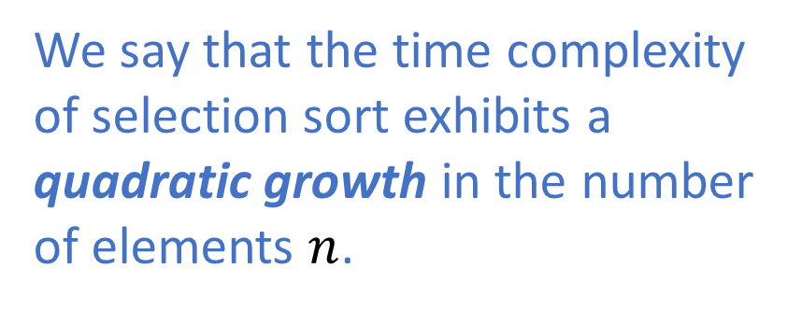
Complexity Growth of Selection Sort
We say that the time complexity of selection sort exhibits a quadratic growth in the number of elements $n$.

Slide 21
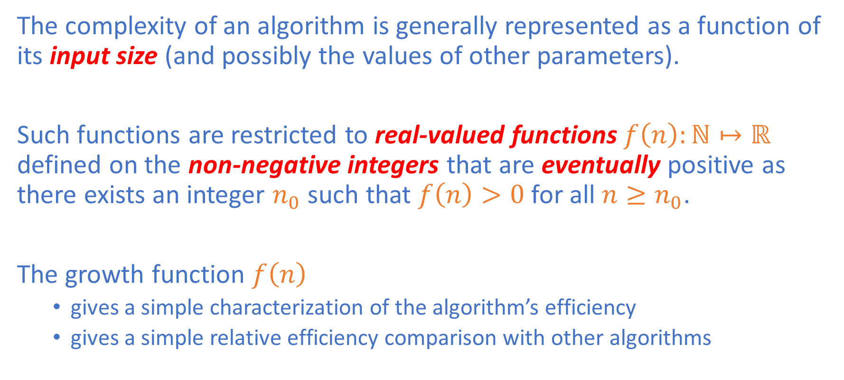
Complexity Growth
The complexity of an algorithm is generally represented as a function of its input size (and possibly the values of other parameters).
Such functions are restricted to real-valued functions $f\left(n\right):ℕ↦ℝ$ defined on the non-negative integers that are eventually positive as there exists an integer $n_{0}$ such that $f\left(n\right)>0$ for all $n≥n_{0}$.
The growth function $f\left(n\right)$
gives a simple characterization of the algorithm’s efficiency
gives a simple relative efficiency comparison with other algorithms

Slide 22
Asymptotic Analysis
Asymptotic Analysis
Provides machine-independent analysis
Abstracts away from implementation details
Focuses only on the dominating factors
For sufficiently large input sizes, a linear-time algorithm with a moderately big constant overhead will eventually run faster than a quadratic-time one with a relatively small constant overhead.

Slide 23
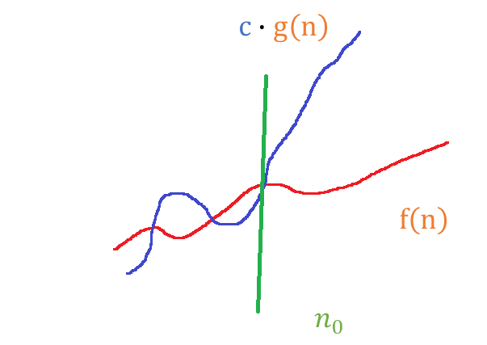

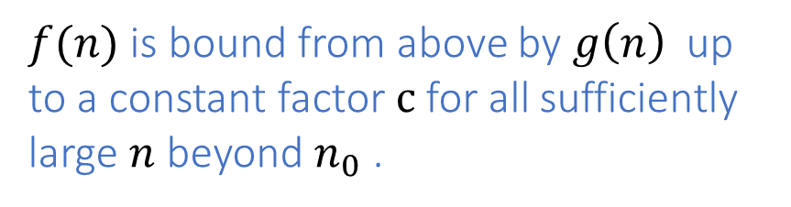
Definition of Big-Oh
A function $f(n)$ is in $O(g\left(n\right))$ if and only if
$∃c∈ℝ^{+}∃n_{0}εℕ( ∀n∈ℕ : n≥n_{0}↦f(n)≤cg(n) )$
$f(n)$ is bound from above by $g\left(n\right)$ up to a constant factor $c$ for all sufficiently large $n$ beyond $n_{0}$ .

Slide 24
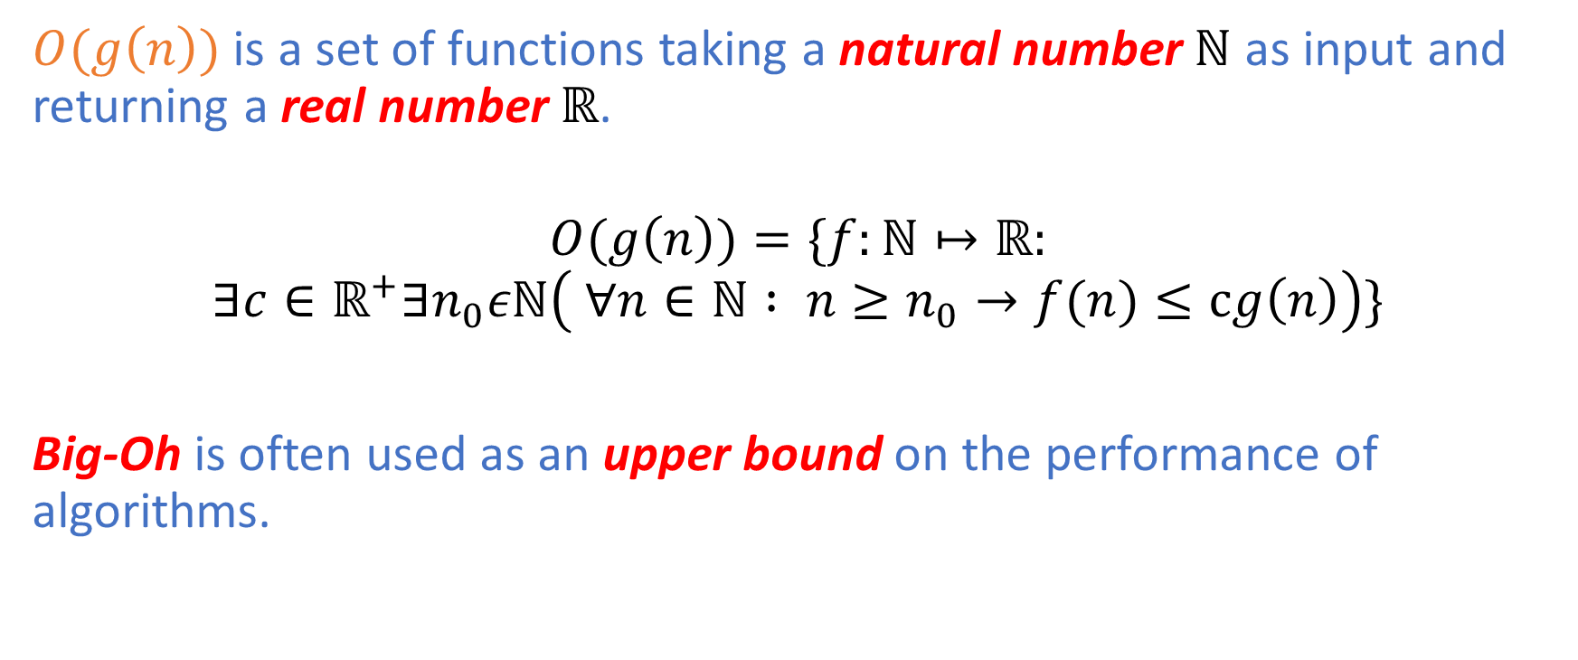
Big-Oh Notation
$O(g\left(n\right))$ is a set of functions taking a natural number $ℕ$ as input and returning a real number $ℝ$.
$$O(g\left(n\right))=\{f:ℕ↦ℝ:$$
$$∃c∈ℝ^{+}∃n_{0}εℕ\left( ∀n∈ℕ : n≥n_{0}→f(n)≤cg\left(n\right)\right)\}$$
Big-Oh is often used as an upper bound on the performance of algorithms.

Slide 25
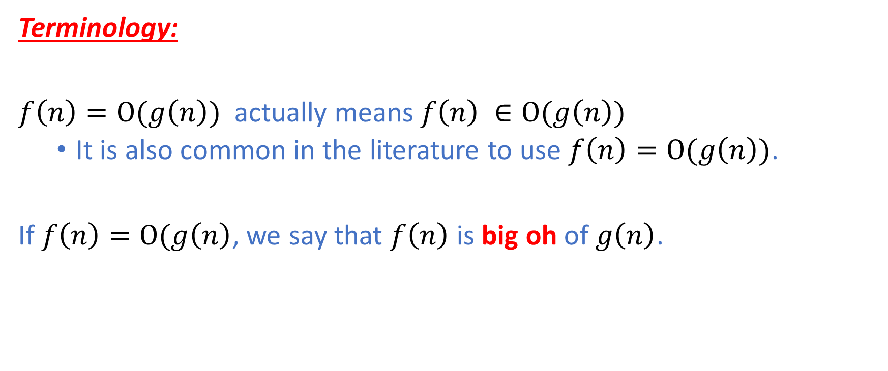
Big-Oh Notation
Terminology:
$f\left(n\right)=O(g\left(n\right))$ actually means$f\left(n\right) ∈O(g\left(n\right))$
It is also common in the literature to use $f\left(n\right)=O(g\left(n\right))$.
If $f\left(n\right)=O(g\left(n\right)$, we say that $f\left(n\right)$ is big oh of $g\left(n\right)$.

Slide 26
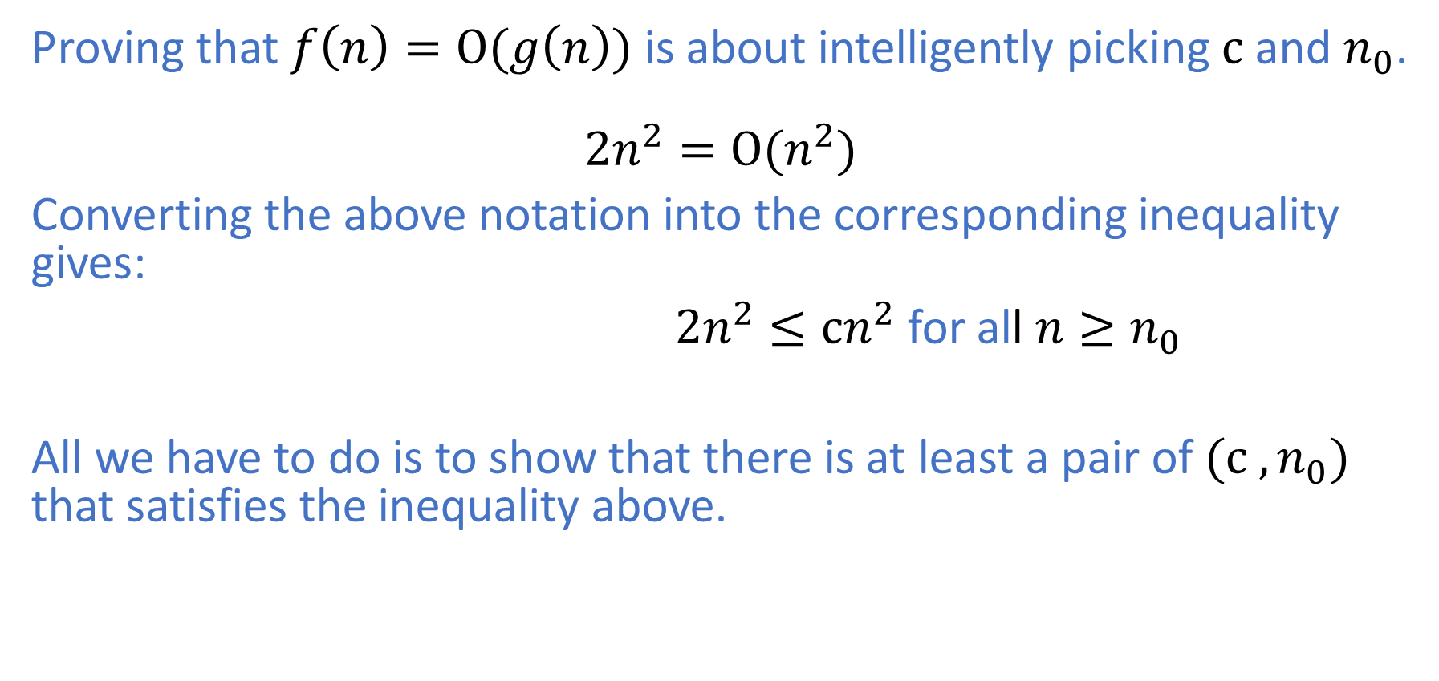

Proving $f\left(n\right)=O(g\left(n\right))$
Proving that $f\left(n\right)=O(g\left(n\right))$is about intelligently picking $c$ and $n_{0}$.
$${2n}^{2}=O(n^{2})$$
Converting the above notation into the corresponding inequality gives:
${2n}^{2}≤cn^{2}$ for all $n≥n_{0}$
All we have to do is to show that there is at least a pair of ${(c ,n}_{0})$ that satisfies the inequality above.

Slide 27
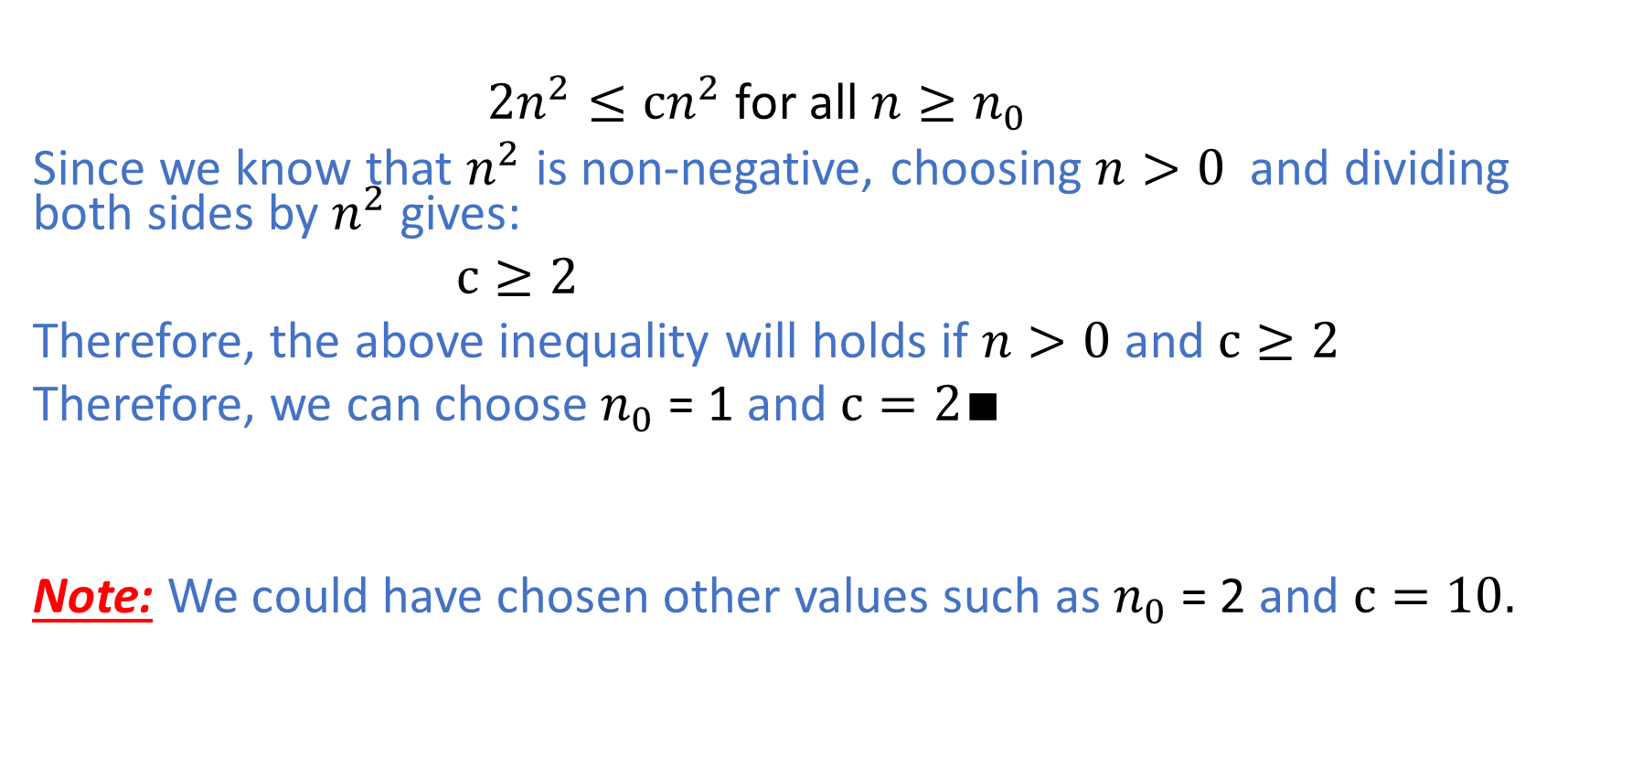

Proving $f\left(n\right)=O(g\left(n\right))$
${2n}^{2}≤cn^{2}$ for all $n≥n_{0}$
Since we know that $n^{2}$ is non-negative, choosing $n>0$ and dividing both sides by $n^{2}$ gives:
$c≥2$
Therefore, the above inequality will holds if $n>0$ and $c≥2$
Therefore, we can choose $n_{0}$ = 1 and $c=2∎$
Note: We could have chosen other values such as $n_{0}$ = 2 and $c=10.$

Slide 28
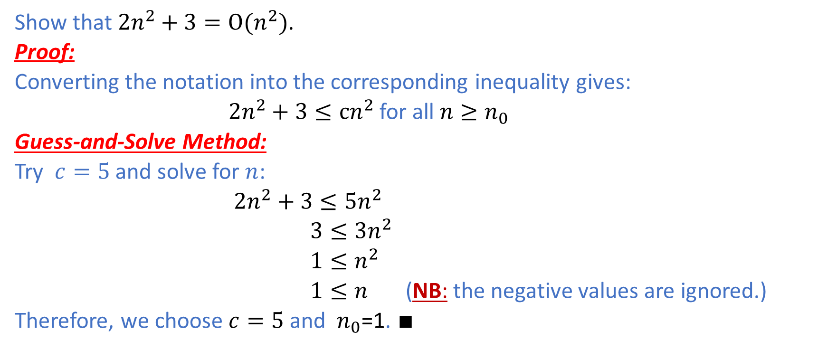
Example 1: Guess-and-Solve Method
Show that ${2n}^{2}+3=O(n^{2})$.
Proof:
Converting the notation into the corresponding inequality gives:
${2n}^{2}+3≤cn^{2}$for all $n≥n_{0}$
Guess-and-Solve Method:
Try $c=5$ and solve for $n$:
${2n}^{2}+3≤5n^{2}$
$3≤3n^{2}$
${ 1≤n}^{2}$
$1≤n$ (NB: the negative values are ignored.)
Therefore, we choose $c=5$ and $n_{0}$=1. $∎$

Slide 29
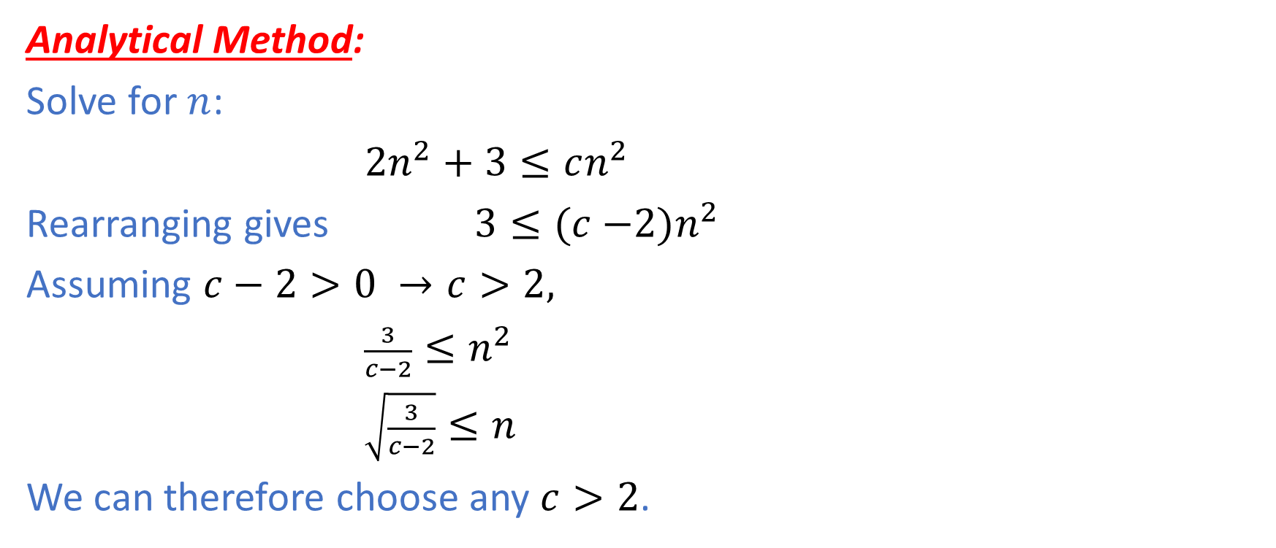
Example 1: Analytical Method
Analytical Method:
Solve for $n$:
${2n}^{2}+3≤cn^{2}$
Rearranging gives $3≤(c{−2)n}^{2}$
Assuming $c−2>0 →c>2,$
$\frac{3}{c−2}≤n^{2}$
$\sqrt{\frac{3}{c−2}}≤n$
We can therefore choose any $c>2$.

Slide 30
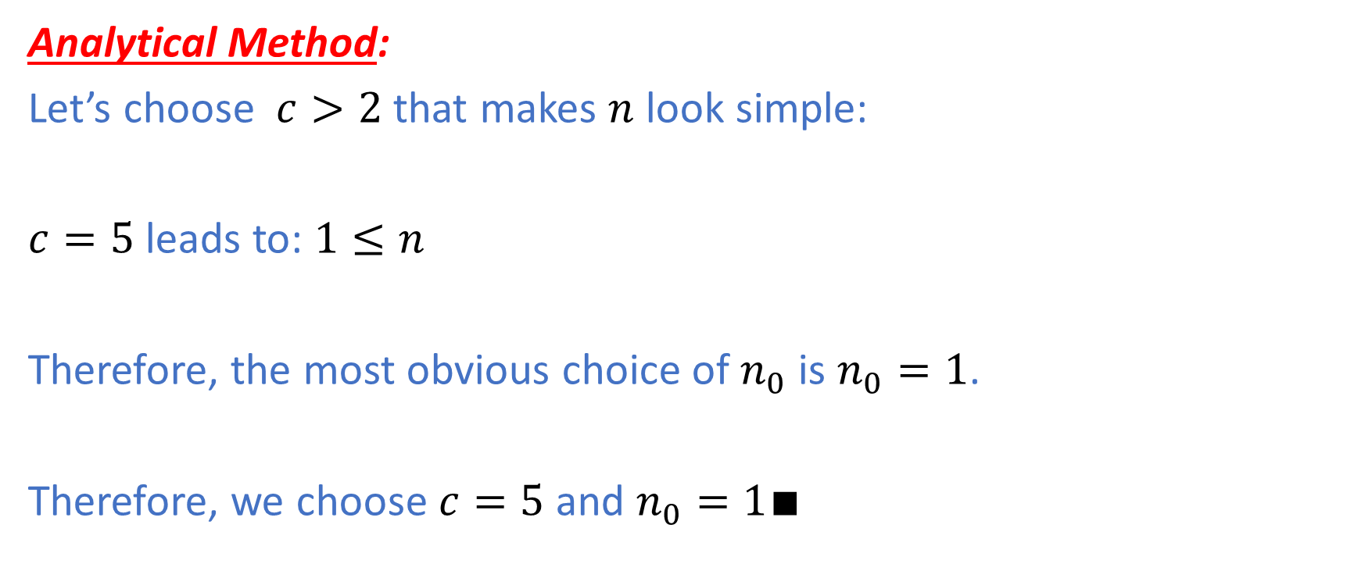
Example 1: Analytical Method (Continued)
Analytical Method:
Let’s choose $c>2$ that makes $n$ look simple:
$c=5$ leads to: $1≤n$
Therefore, the most obvious choice of $n_{0}$ is $n_{0}=1$.
Therefore, we choose $c=5$ and $n_{0}=1∎$

Slide 31

Example 1: Mutation Method
Mutation Method:
${2n}^{2}+3≤3n^{2}+3$ for all $n≥1$
$≤3n^{2}+3n^{2}$ for all $n≥1$
$=6n^{2}$ for all $n≥1$
Therefore, we choose $c=6$ and $n_{0}=1∎$

Slide 32
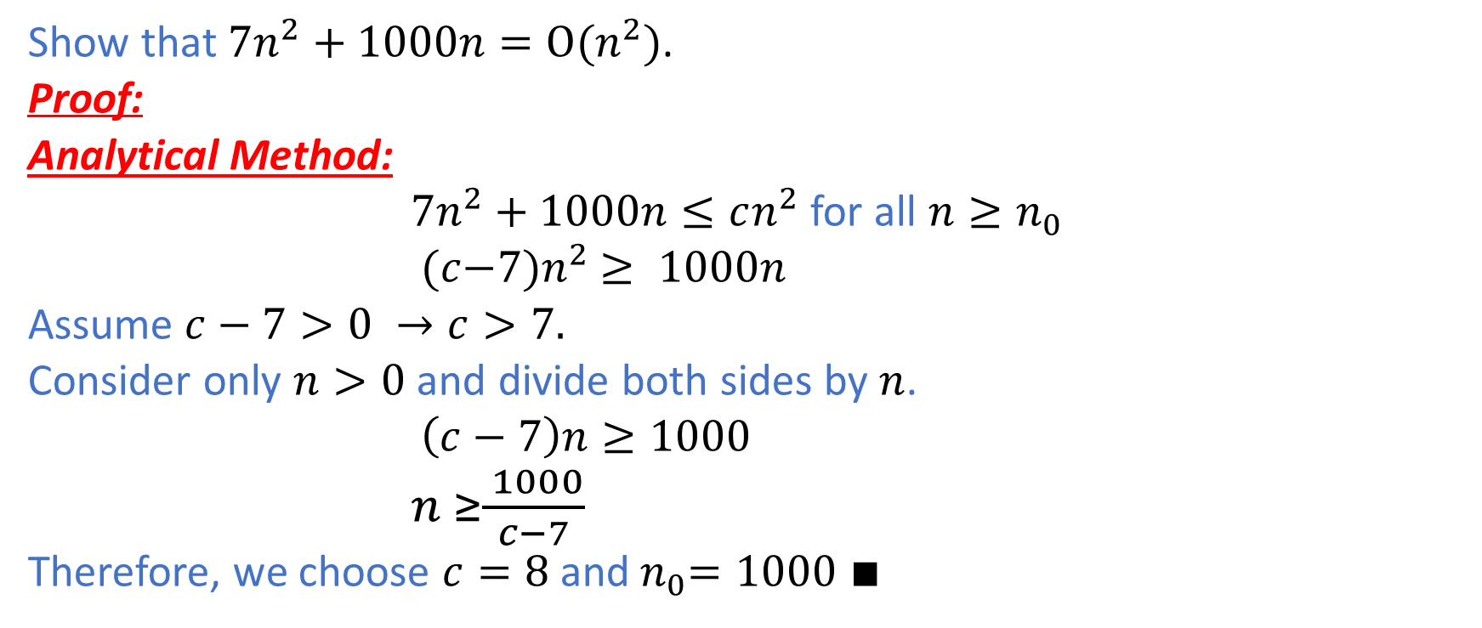
Example 2: Analytical Method
Show that ${7n}^{2}+1000n=O(n^{2})$.
Proof:
Analytical Method:
${7n}^{2}+1000n≤cn^{2}$ for all $n≥n_{0}$
$(c{−7)n}^{2} ≥ 1000n$
Assume $c−7>0 →c>7.$
Consider only $n>0$ and divide both sides by $n$.
$\left(c−7\right)n≥1000$
$n ≥\frac{ 1000}{c−7}$
Therefore, we choose $c=8$ and${ n}_{0}=1000$ $∎$

Slide 33
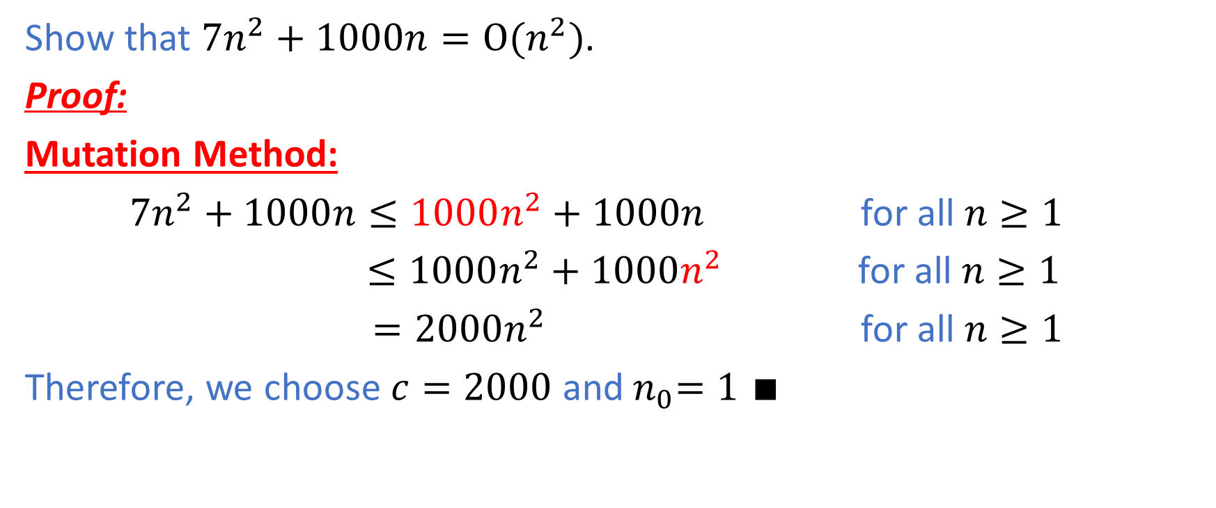
Example 2: Mutation Method
Show that ${7n}^{2}+1000n=O(n^{2})$.
Proof:
Mutation Method:
${7n}^{2}+1000n≤1000n^{2}+1000n$ for all $n≥1$
$≤1000n^{2}+1000n^{2}$ for all $n≥1$
$=2000n^{2}$ for all $n≥1$
Therefore, we choose $c=2000$ and${ n}_{0}=1$ $∎$

Slide 34
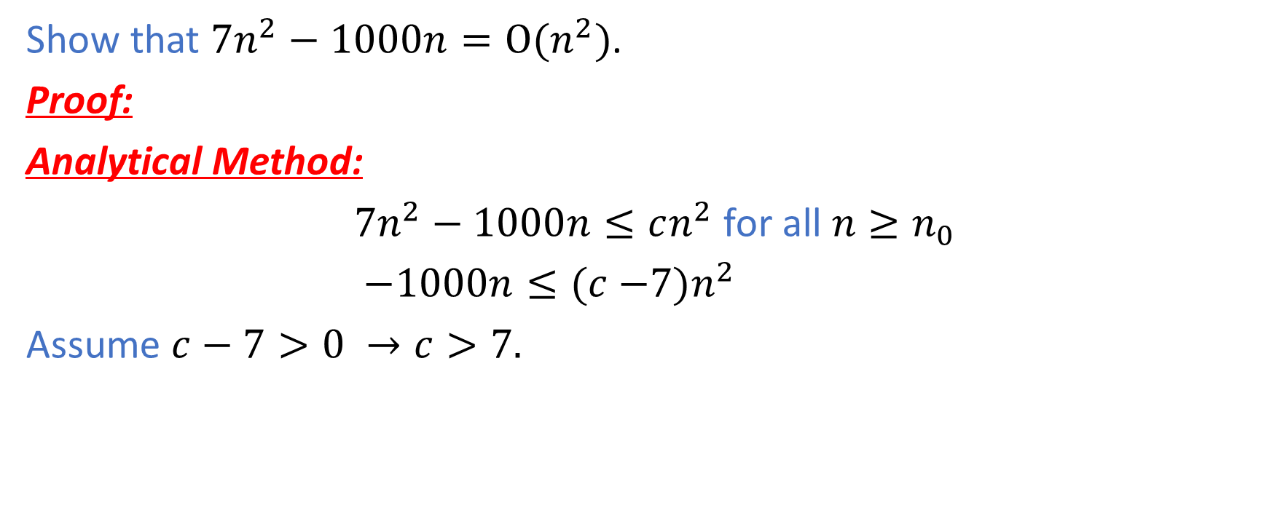
Example 3: Analytical Method
Show that ${7n}^{2}−1000n=O(n^{2})$.
Proof:
Analytical Method:
${7n}^{2}−1000n≤cn^{2}$ for all $n≥n_{0}$
$−1000n≤(c{−7)n}^{2}$
Assume $c−7>0 →c>7.$

Slide 35
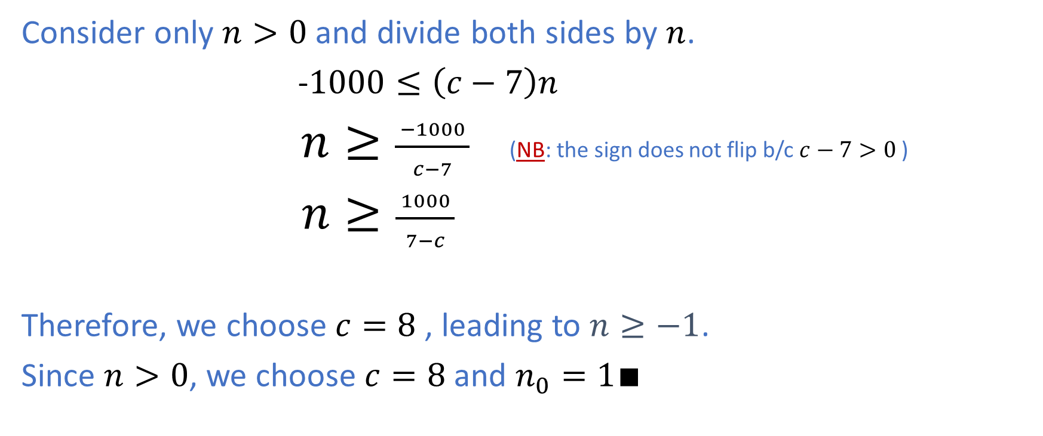
Example 3: Analytical Method (Continued)
Consider only $n>0$ and divide both sides by $n$.
-$1000≤\left(c−7\right)n$
$n≥\frac{ −1000 }{c−7}$ (NB: the sign does not flip b/c $c−7>0$ )
$n≥\frac{ 1000 }{7−c}$
Therefore, we choose $c=8$, leading to $n≥−1$.
Since $n>0$, we choose $c=8$ and $n_{0}=1∎$

Slide 36
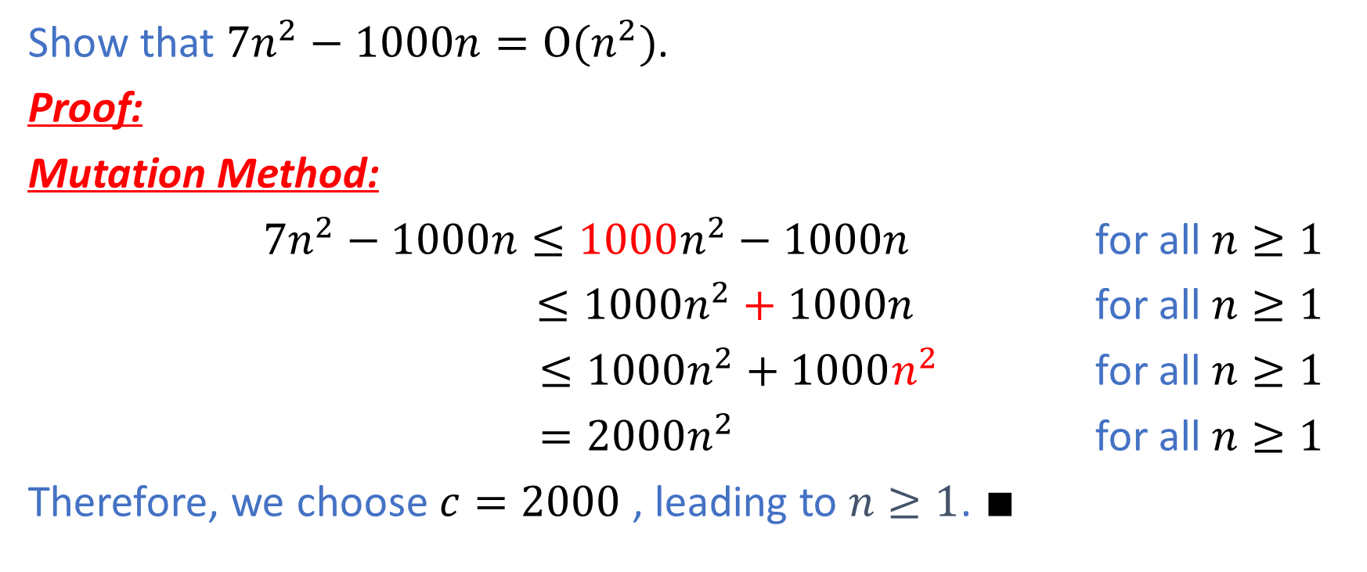
Example 3: Mutation Method
Show that ${7n}^{2}−1000n=O(n^{2})$.
Proof:
Mutation Method:
${7n}^{2}−1000n≤1000n^{2}−1000n$ for all $n≥1$
$≤1000n^{2}+1000n$ for all $n≥1$
$≤1000n^{2}+1000n^{2}$ for all $n≥1$
$=2000n^{2}$ for all $n≥1$
Therefore, we choose $c=2000$, leading to $n≥1$. $∎$

Slide 37
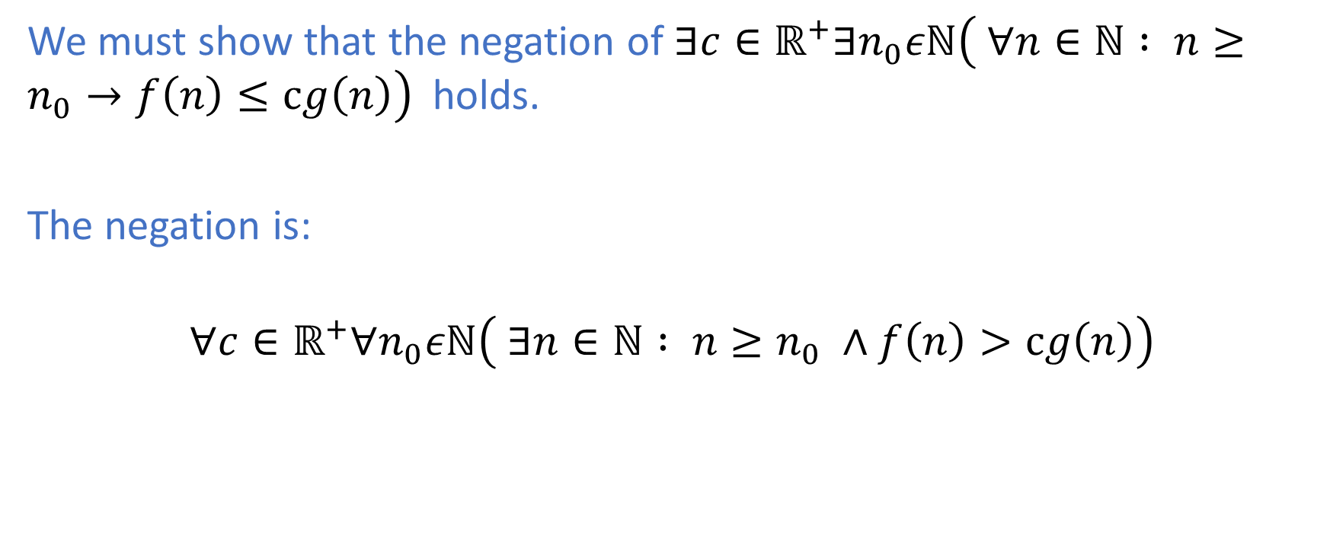

Disproving $f\left(n\right)∉O(g\left(n\right))$
We must show that the negation of $∃c∈ℝ^{+}∃n_{0}εℕ\left( ∀n∈ℕ : n≥n_{0}→f\left(n\right)≤cg\left(n\right)\right)$ holds.
The negation is:
$$∀c∈ℝ^{+}∀n_{0}εℕ\left( ∃n∈ℕ : n≥n_{0} ∧f\left(n\right)>cg\left(n\right)\right)$$

Slide 38
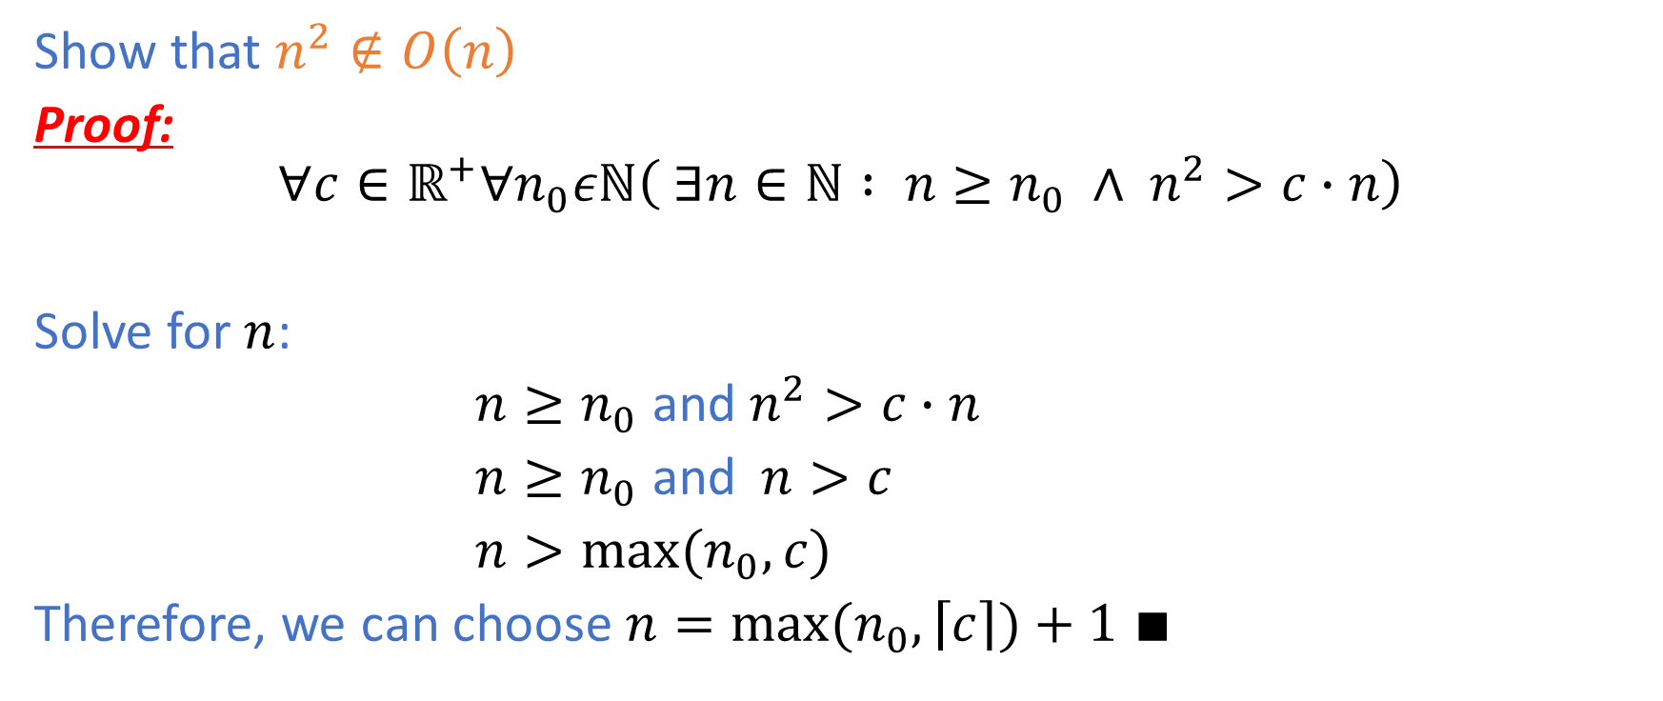
Example 4
Show that $n^{2}∉O\left(n\right)$
Proof:
$$∀c∈ℝ^{+}∀n_{0}εℕ\left( ∃n∈ℕ : n≥n_{0} ∧ n^{2}>c∙n\right)$$
Solve for $n$:
$n≥n_{0}$ and $n^{2}>c∙n$
$n≥n_{0}$ and$n>c$
$n>{max⁡(n}_{0},c)$
Therefore, we can choose $n={max⁡(n}_{0},\left\lceil c\right\rceil )+1$ $∎$

Slide 39
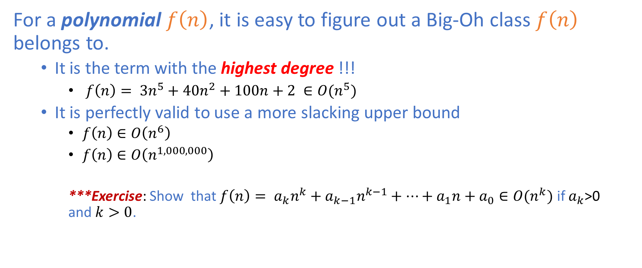
Comparing Polynomial Functions
For a polynomial $f\left(n\right)$, it is easy to figure out a Big-Oh class $f\left(n\right)$ belongs to.
It is the term with the highest degree !!!
$f\left(n\right)= {3n}^{5}+4{0n}^{2}+100n+2 ∈O(n^{5})$
It is perfectly valid to use a more slacking upper bound
$f\left(n\right)∈O\left(n^{6}\right)$
$f\left(n\right)∈O\left(n^{1,000,000}\right)$
***Exercise: Show that $f\left(n\right)= a_{k}n^{k}+a_{k−1}n^{k−1}+…+a_{1}n+a_{0}∈O(n^{k})$ if $a_{k}$>0 and$k>0$.

Slide 40
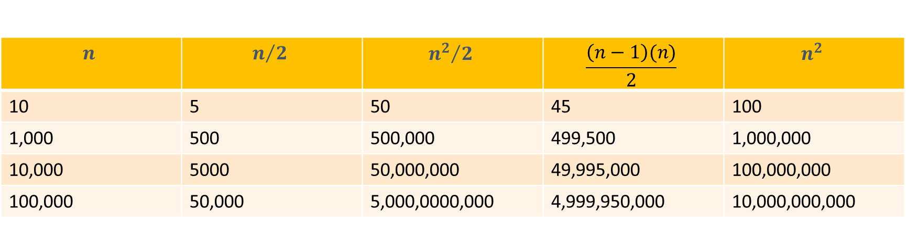
Comparing Polynomial Functions
$$n$$ | $$n/2$$ | $${n^{2}}/2$$ | $$\frac{\left(n−1\right)(n)}{2}$$ | $$n^{2}$$
10 | 5 | 50 | 45 | 100
1,000 | 500 | 500,000 | 499,500 | 1,000,000
10,000 | 5000 | 50,000,000 | 49,995,000 | 100,000,000
100,000 | 50,000 | 5,000,0000,000 | 4,999,950,000 | 10,000,000,000
Table comparing linear and quadratic growth

Slide 41
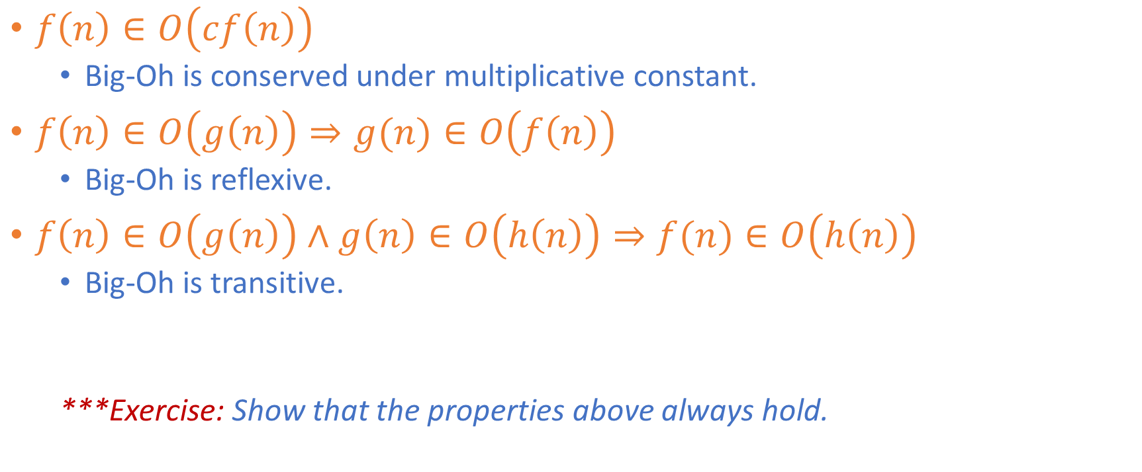
Properties of Big-Oh
$f\left(n\right)∈O\left(cf\left(n\right)\right)$
Big-Oh is conserved under multiplicative constant.
$f\left(n\right)∈O\left(g\left(n\right)\right)⇒g(n)∈O\left(f\left(n\right)\right)$
Big-Oh is reflexive.
$f\left(n\right)∈O\left(g\left(n\right)\right)∧g\left(n\right)∈O\left(h\left(n\right)\right)⇒f(n)∈O\left(h\left(n\right)\right)$
Big-Oh is transitive.
***Exercise: Show that the properties above always hold.

Slide 42
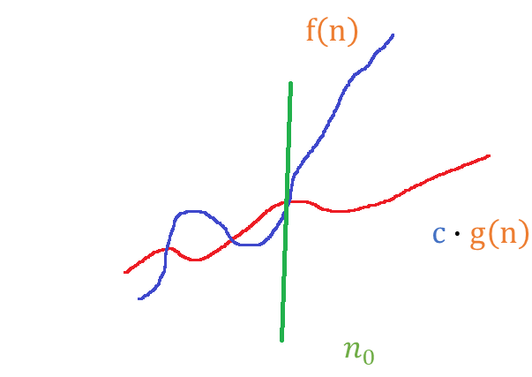

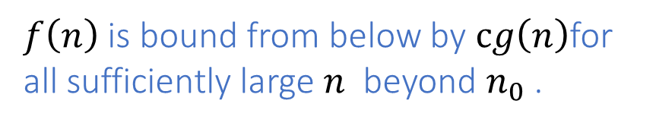
Definition of Big Omega
A function$f\left(n\right)$ is in $Ω(g\left(n\right))$if and only if
$∃c∈ℝ^{+}∃n_{0}εℕ( ∀n∈ℕ : n≥n_{0}→f\left(n\right)≥c∙g\left(n\right) )$
$f\left(n\right)$ is bound from below by $cg\left(n\right)$for all sufficiently large $n$ beyond $n_{0}$ .

Slide 43
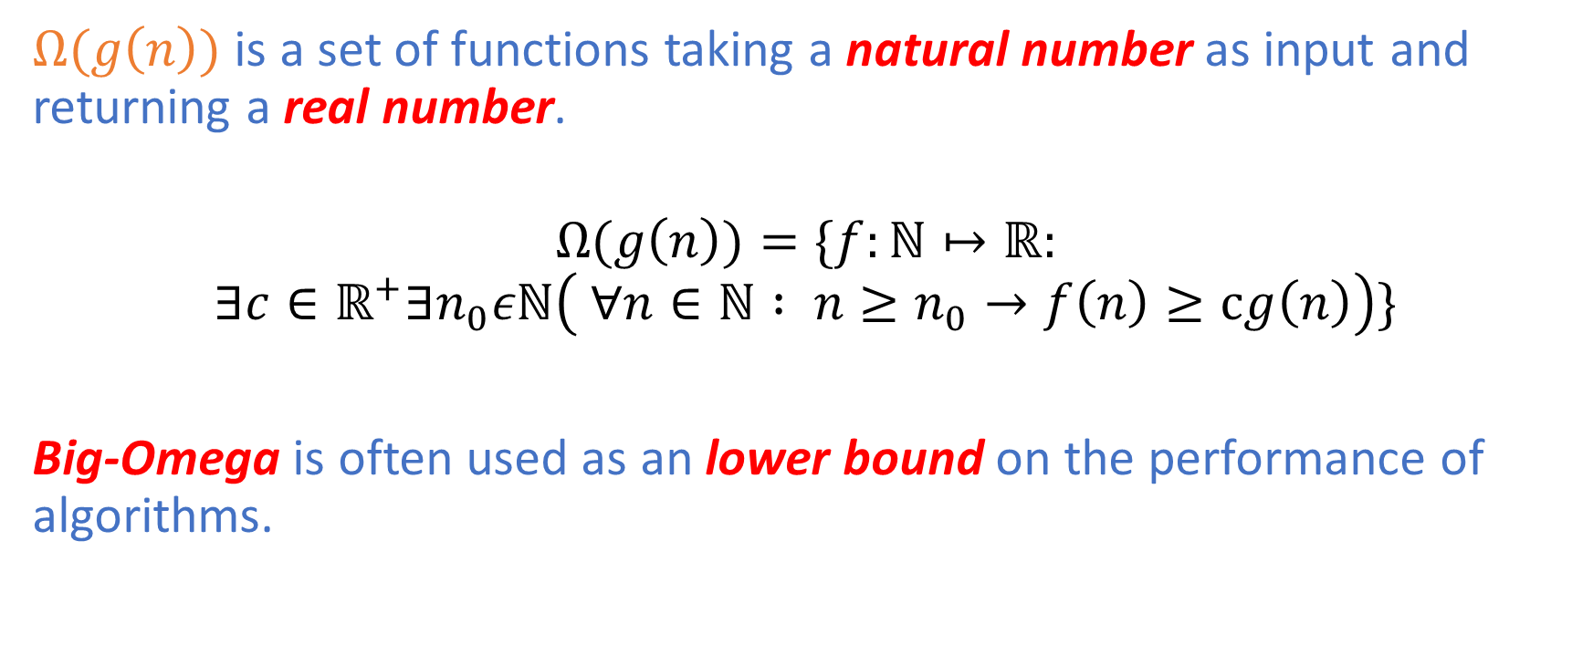
Big-Omega Notation
$Ω(g\left(n\right))$ is a set of functions taking a natural number as input and returning a real number.
$$Ω(g\left(n\right))=\{f:ℕ↦ℝ:$$
$$∃c∈ℝ^{+}∃n_{0}εℕ\left( ∀n∈ℕ : n≥n_{0}→f\left(n\right)≥cg\left(n\right)\right)\}$$
Big-Omega is often used as an lower bound on the performance of algorithms.

Slide 44
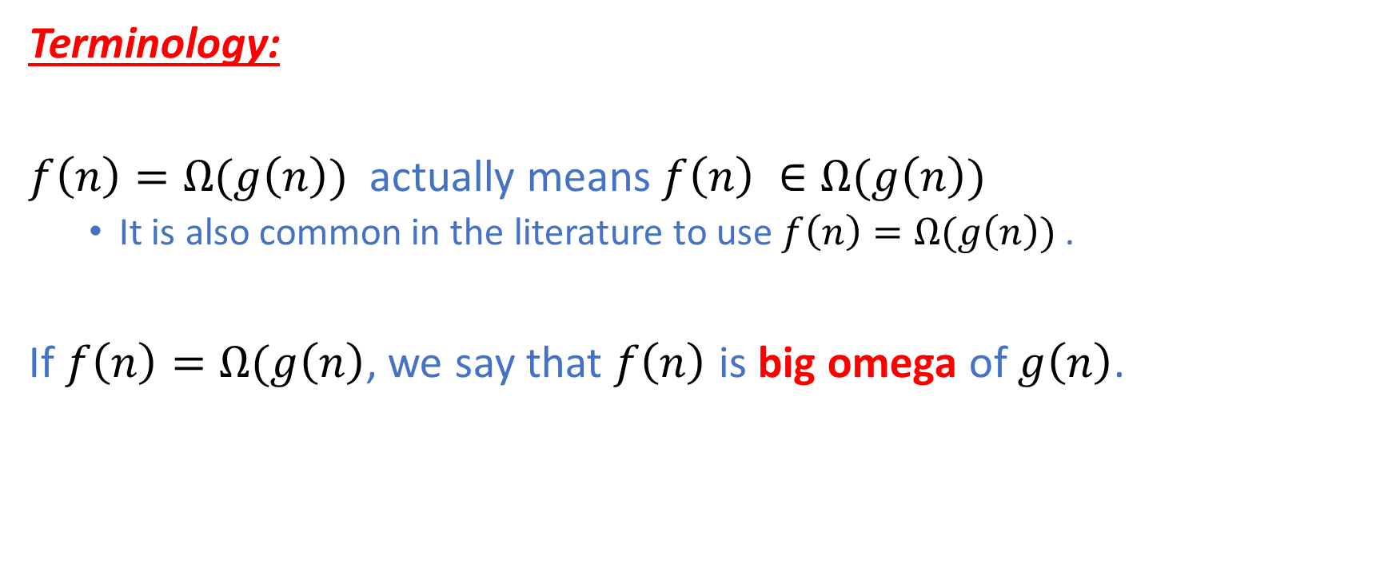
Big-Omega
Terminology:
$f\left(n\right)=Ω(g\left(n\right))$ actually means$f\left(n\right) ∈Ω(g\left(n\right))$
It is also common in the literature to use $f\left(n\right)=Ω(g\left(n\right))$ .
If $f\left(n\right)=Ω(g\left(n\right)$, we say that $f\left(n\right)$ is big omega of $g\left(n\right)$.

Slide 45
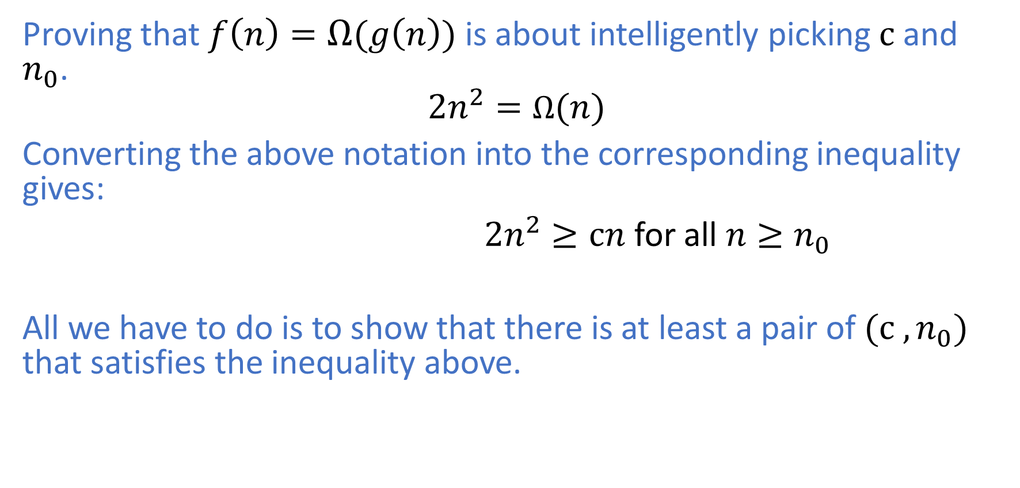

Proving $f\left(n\right)=Ω(g\left(n\right))$
Proving that $f\left(n\right)=Ω(g\left(n\right))$is about intelligently picking $c$ and $n_{0}$.
$${2n}^{2}=Ω(n)$$
Converting the above notation into the corresponding inequality gives:
${2n}^{2}≥cn$ for all $n≥n_{0}$
All we have to do is to show that there is at least a pair of ${(c ,n}_{0})$ that satisfies the inequality above.

Slide 46
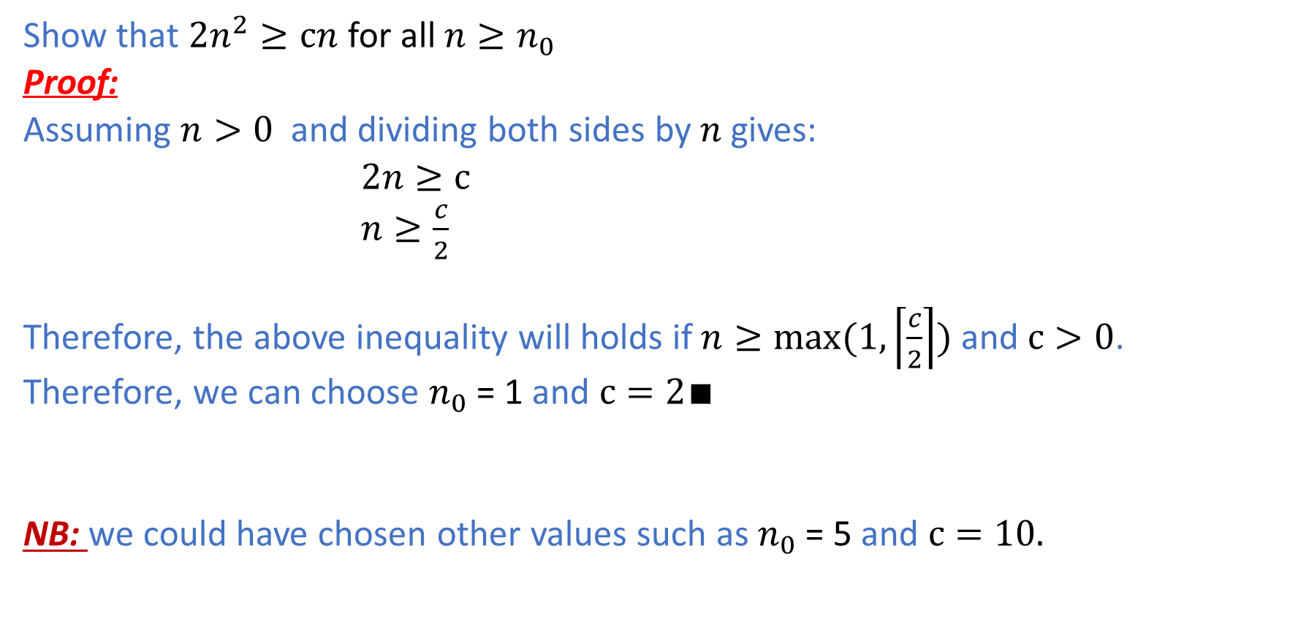
Example 5
Show that ${2n}^{2}≥cn$ for all $n≥n_{0}$
Proof:
Assuming $n>0$ and dividing both sides by $n$gives:
$2n≥c$
$n≥\frac{c}{2}$
Therefore, the above inequality will holds if $n≥max⁡(1,\left\lceil \frac{c}{2}\right\rceil )$ and $c>0$.
Therefore, we can choose $n_{0}$ = 1 and $c=2∎$
NB: we could have chosen other values such as $n_{0}$ = 5 and $c=10.$

Slide 47

Big-Omega of Polynomials
***Exercise:
$f\left(n\right)= a_{k}n^{k}+a_{k−1}n^{k−1}+…+a_{1}n+a_{0}∈Ω(n^{k})$ if $a_{k}$>0 and$k>0$.

Slide 48
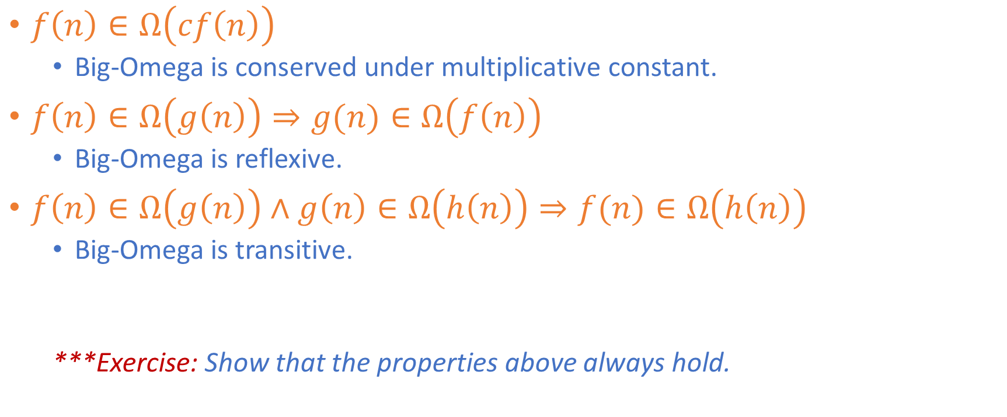
Properties of Big-Omega
$f\left(n\right)∈Ω\left(cf\left(n\right)\right)$
Big-Omega is conserved under multiplicative constant.
$f\left(n\right)∈Ω\left(g\left(n\right)\right)⇒g(n)∈Ω\left(f\left(n\right)\right)$
Big-Omega is reflexive.
$f\left(n\right)∈Ω\left(g\left(n\right)\right)∧g\left(n\right)∈Ω\left(h\left(n\right)\right)⇒f(n)∈Ω\left(h\left(n\right)\right)$
Big-Omega is transitive.
***Exercise: Show that the properties above always hold.

Slide 49
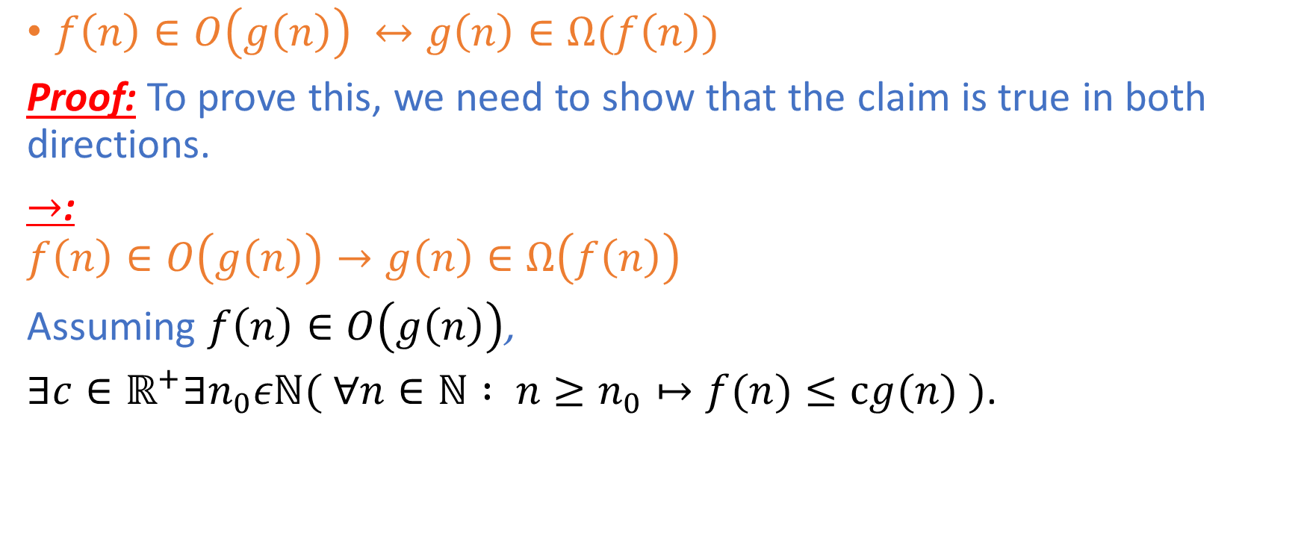
Big-Oh and Big-Omega
$f\left(n\right)∈O\left(g\left(n\right)\right) ↔g\left(n\right)∈Ω(f\left(n\right))$
Proof: To prove this, we need to show that the claim is true in both directions.
$→$:
$$f\left(n\right)∈O\left(g\left(n\right)\right)→g\left(n\right)∈Ω\left(f\left(n\right)\right)$$
Assuming $f\left(n\right)∈O\left(g\left(n\right)\right)$,
$∃c∈ℝ^{+}∃n_{0}εℕ( ∀n∈ℕ : n≥n_{0}↦f(n)≤cg(n) )$.

Slide 50
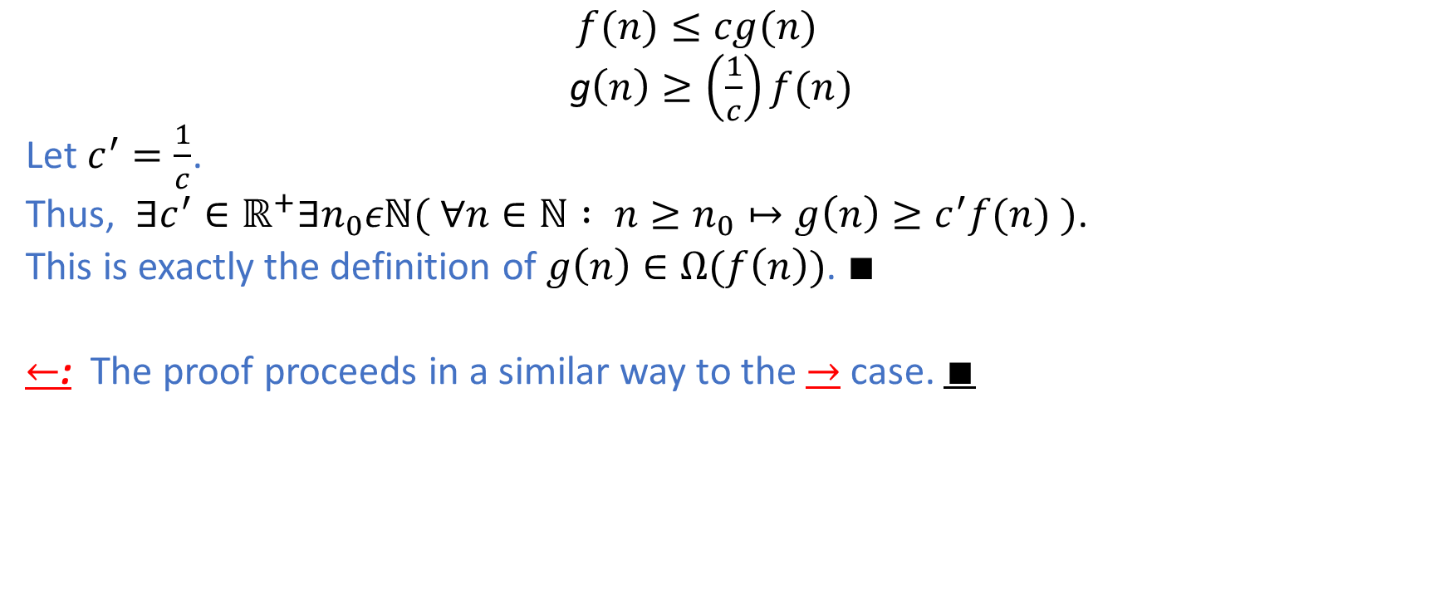
Big-Oh and Big-Omega
$f(n)≤cg(n)$
g$\left(n\right)≥\left(\frac{1}{c}\right)f(n)$
Let $c^{′}=\frac{1}{c}$.
Thus, $∃c^{′}∈ℝ^{+}∃n_{0}εℕ( ∀n∈ℕ : n≥n_{0}↦g\left(n\right)≥c^{′}f(n) )$.
This is exactly the definition of $g\left(n\right)∈Ω(f\left(n\right))$. $∎$
$←$: The proof proceeds in a similar way to the $→$ case. $∎$

Slide 51
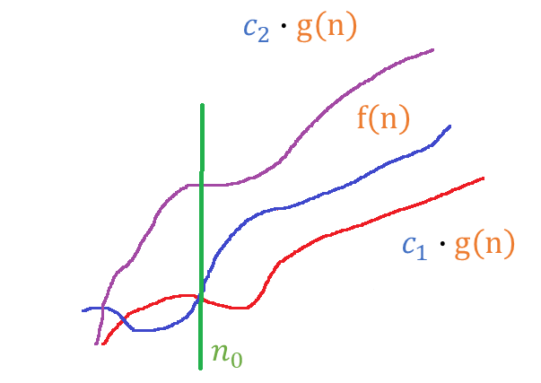

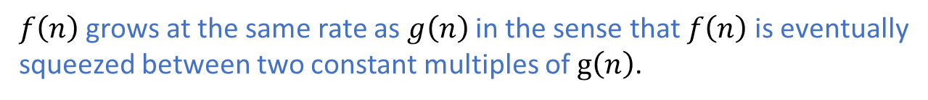
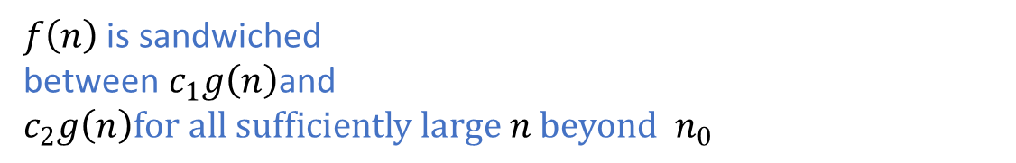
Definition of Big Theta
A function$f\left(n\right)$ is in $Θ(g\left(n\right))$if and only if
$$∃c_{1}{∈ℝ^{+}∃c}_{2}∈ℝ^{+}∃n_{0}εℕ( ∀n∈ℕ : n≥n_{0}→c_{1}∙g\left(n\right)≤f\left(n\right)≤c_{2}∙g\left(n\right))$$
$f\left(n\right)$ is sandwiched between$c_{1}g\left(n\right)$and$c_{2}g\left(n\right)for all sufficiently large n beyond { n}_{0}$
$f\left(n\right)$ grows at the same rate as $g\left(n\right)$ in the sense that $f\left(n\right)$ is eventually
squeezed between two constant multiples of $g\left(n\right)$.

Slide 52
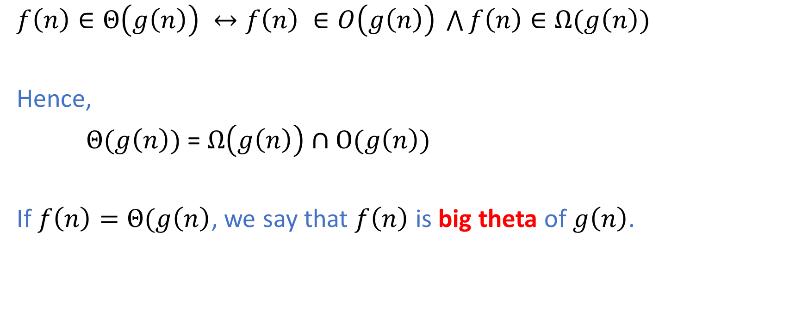
Definition of Big Theta
$f\left(n\right)∈Θ\left(g\left(n\right)\right) ↔f\left(n\right) ∈O\left(g\left(n\right)\right) \bigwedge{f\left(n\right)∈Ω(g\left(n\right))}$
Hence,
$Θ(g\left(n\right))$ = $Ω\left(g\left(n\right)\right)∩O(g\left(n\right))$
If $f\left(n\right)=Θ(g\left(n\right)$, we say that $f\left(n\right)$ is big theta of $g\left(n\right)$.

Slide 53

Example 6
Show that $\frac{n^{2}}{2}−3n= Θ\left(n^{2}\right)$
Proof:
${ c}_{1}n^{2}$ $≤\frac{n^{2}}{2}−3n≤c_{2}n^{2}$ for all $n≥n_{0}$
Dividing both sides by $n^{2}>0$ gives:
${ c}_{1}$ $≤\frac{1}{2}−\frac{3}{n}≤c_{2}$

Slide 54


Example 6 (Continued)
Lower Bound:
${ c}_{1}$ $≤\frac{1}{2}−\frac{3}{n}$
${ c}_{1}$ $≤\frac{n−6}{2n}$
$n\left(1−2c_{1}\right)≥6$
Assuming $1−2c_{1}>0→c_{1}<\frac{1}{2}$
$n≥\frac{6}{1−2c_{1}}$
Choose $c_{1}=\frac{1}{4},n_{01}=12$.
We have just proven $f\left(n\right)=Ω(g\left(n\right))$as a by-product.

Slide 55

Example 6 (Continued)
Upper Bound:
$\frac{1}{2}−\frac{3}{n}≤c_{2}$
${ c}_{2}$ $≥\frac{n−6}{2n}$
$n\left(1−2c_{2}\right)≤6$
Assuming $1−2c_{2}<0→c_{2}>\frac{1}{2}$
$n≥\frac{6}{1−2c_{2}}$
Choose $c_{2}=1,{ n}_{02}=1.$
We have just proven $f\left(n\right)=O(g\left(n\right))$as a by-product.

Slide 56

Example 6 (Continued)
Therefore, ${c_{1}=\frac{1}{4},c}_{2}=1,{ n}_{0}=\max\left({{ n}_{01},n}_{02}\right)=\max\left(12,1\right)=12∎$

Slide 57

Properties of Big Theta
$f\left(n\right)∈Θ(f\left(n\right))$ (Reflexive)
$f\left(n\right)$ has the same order as itself.
$f\left(n\right)∈Θ\left(g\left(n\right)\right)⇒g\left(n\right)∈Θ\left(f\left(n\right)\right)$ (Symmetric)
$f\left(n\right)$ has the same order as $g\left(n\right)$, then $g\left(n\right)$ has the same order as$f\left(n\right)$.
$f\left(n\right)∈Θ\left(g\left(n\right)\right)∧g\left(n\right)∈Θ\left(h\left(n\right)\right)⇒f(n)∈Θ\left(h\left(n\right)\right)$ (Transitive)
$f\left(n\right)$ has the same order as $g\left(n\right)$, and $g\left(n\right)$ has the same order as$h\left(n\right),$
then $f\left(n\right)$ has the same order as $h\left(n\right)$.

Slide 58

Orders of Growth
$$O\left(1\right)⊂O(log{n)⊂}O(n)⊂O(nlog{n)⊂O(n^{2})}$$
$⊂{O(n}^{3})⊂O$($2^{n}$) $⊂$ $O$($3^{n}$) $⊂$ $O$($n$!)
Proofs involving non-polynomial functions may require calculus and mathematical induction.
We will cover induction in the next lecture.

Slide 59

More Practice Examples
Show that ${2021n}^{2}+2020n+2019=O(n^{3})$.
Proof:
${2021n}^{2}+2020n+2019≤2021n^{2}+2020n^{2}+2019n^{2}$ for all $n≥1$
$≤2021n^{2}+2021n^{2}+2021n^{2}$ for all $n≥1$
$≤2021n^{3}+2021n^{2}+2021n^{2}$ for all $n≥1$
$≤2021n^{3}+2021n^{3}+2021n^{3}$ for all $n≥1$
$=3∙2021n^{3}$ for all $n≥1$
$=6063n^{3}$ for all $n≥1$
Hence, we can choose ${ n}_{0}=1$ and $c=6063$. $∎$

Slide 60

More Practice Examples
Show that $n^{2}+2^{n}=O(2^{n})$.
Proof:
$n^{2}≤2^{n}$ for all $n≥4$ (1)
$2^{n}≤2^{n}$ for all $n≥1$ (2)
(1)+(2): ${n^{2}+2}^{n}≤{2^{n}+2}^{n}$ for all $n≥max\left(1,4\right)=4$ ${n^{2}+2}^{n}≤{2∙2}^{n}$ for all $n≥4$
Hence, we can choose ${ n}_{0}=4$ and $c=2$. $∎$

